Slide 1
CS 4530: Fundamentals of Software Engineering Lesson 5.2 Continuous Deployment
Rob Simmons
Khoury College of Computer Sciences

Slide 2
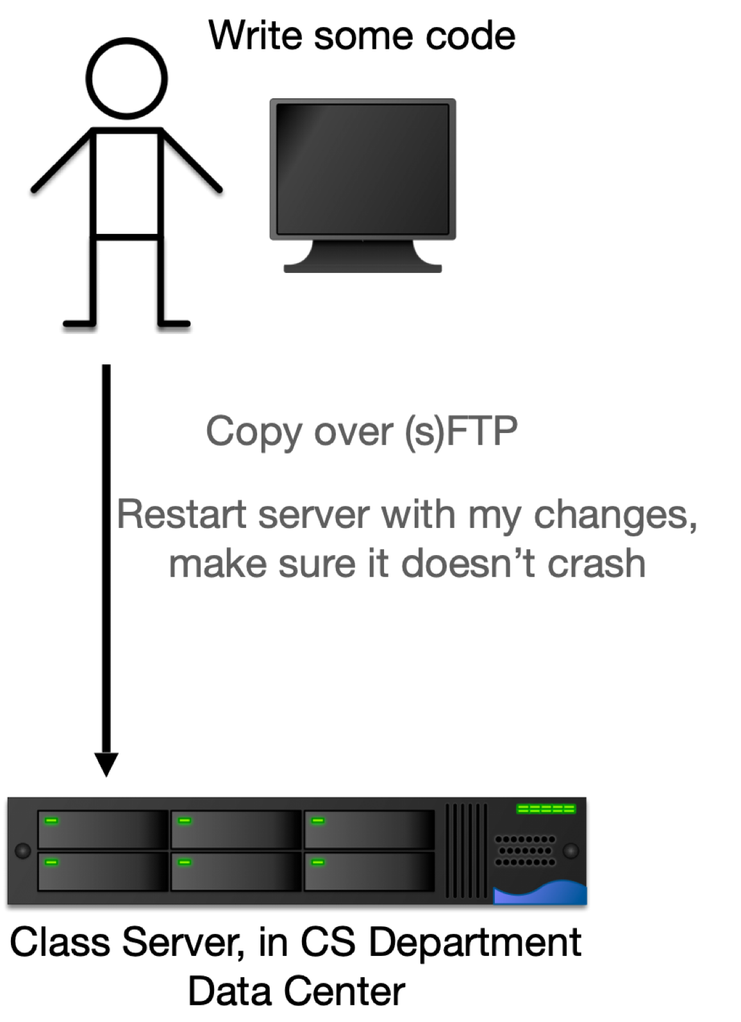
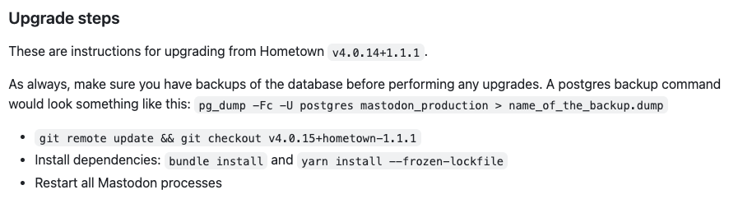
How to (re)deploy a web app?
Very old school: copy over SFTP, restart the server
Also very old school: SSH in and edit the code on the server directly
Slightly less terrifying: have the code in a git repository, SSH in, update the repo, restart server
https://github.com/hometown-fork/hometown/releases
This is… not agile.

Slide 3
Agile Goal: continuous deployment
Whenever we commit to the main branch of our repository, we want to update the service running to users

Slide 4
Continuous Deployment for Static Sites
GitHub reports that the main branch is updated
Spin up a VM that checks out the repo
Build the files for the website
Send those files to a PaaS that serves it to users
Shut down VM
Render.com will do this for free!
GitHub Pages will too — that’s how the course site works

Slide 5
Continuous Deployment for Web Services
Last version of the web server is puttering away in a VM
GitHub reports that the main branch is updated
Spin up a new VM that checks out the repo
Do any build steps that need to happen to get the web server ready to run
Redirect network traffic from old VM to new VM
Shut down old VM. Zero downtime!
Heroku pioneered this as a business model in 2007, Render.com will do this for free, kinda!
Not actually VMs, but containers
Notes:
This version of events contains two lies: not VMs, but containers

Slide 6
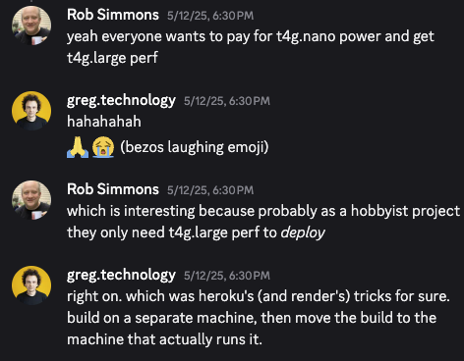
Virtual Machines to Containers
Each VM contains a full operating system
What if each application could run in the same (overall) operating system? Why have multiple copies?
Advantages to smaller apps:
Faster to copy (and hence provision)
Consume less storage (base OS images are usually 3-10GB)
Quite easy and fast to change resources available to a container
Notes:
This problem surfaced within Google in the mid 2000’s, resulting in the development of Linux control groups (cgroups), containers, and docker
”Consume less storage” becomes a very important point for large-scale deployment of small apps. If your app itself is 10-30MB, it’s annoying to have to allocate 10GB of storage for it to hold ubuntu, libc, openssl, nodejs, etc. Container technology lets you share those common OS-level components.
The first lie was that we were using VMs and not containers, and the second lie was that these services tend to move

Slide 7
Containers run layered images, reducing storage space
Images are defined programmatically as a series of “build steps” (e.g. Dockerfile)
Each step in the build becomes a “layer”
Built layers can be shared and cached
To run a container, the layers are linked together with an “overlay” filesystem
FROM node:18-buster-slim
RUN apt-get update && apt-get install python3 build-essential libpango1.0-dev libcairo2-dev libjpeg-dev libgif-dev -y
RUN mkdir -p /usr/src/app
WORKDIR /usr/src/app
COPY ./ /usr/src/app
RUN npm ci
RUN npm run build
CMD [ "npm", "start" ]
Example image specification (Dockerfile)
Our compiled app
Our app
python3, buildessential, pango, cairo, libjpeg, libgif
node:18-buster-slim
Example image, with layers shown

Slide 8
Containers run layered images, reducing storage space
Many images may share the same lower layers (e.g. OS, NodeJS, some system dependencies)
Layers are shared between images
Multi-tenancy: N running containers only require one copy of each layer (they are read-only)
Orion’s compiled app
Ripley’s compiled app
Orion’s app
Ripley’s app
python3, buildessential, pango, cairo, libjpeg, libgif
python3, buildessential, pango, cairo, libjpeg, libgif
node:18-buster-slim
node:18-buster-slim
Two images, sharing two layers
Notes:
(read slide)
A very important note is that you could be running 20 copies of the same container, and only need to store a single copy of each of the layers! Each layer is mounted “read only” in the running container through a file-system-level trick (this is called a “unionfs” in OS-parlance). Each container has its own temporary layer that it can write files to. This can DRAMATICALLY reduce storage needs – especially when there are many containers that share lower layers.

Slide 9
A container contains your apps and all their dependencies
Each application is encapsulated in a “lightweight container,” includes:
System libraries (e.g. glibc)
External dependencies (e.g. nodejs)
“Lightweight” in that container images are smaller than VM images - multi tenant containers run in the OS
Cloud providers offer “containers as a service” (Amazon ECS Fargate, Azure Kubernetes, Google Kubernetes)
Notes:
<read slide>
Kubernetes came out of Google, original internal system was called “Borg”. Automatic Deployment for multiple dockers. It allows you to declare a configuration file like this: “Give me …”. It will manage docker containers for these components on different machines. It could also share services between customers.
Paper: Large-scale cluster management at Google with Borg (2015) https://research.google/pubs/pub43438/

Slide 10

A container contains your apps and all their dependencies
You might put several apps in a single container, together with their dependencies
Might have only one copy of shared dependencies
Container 1
Container 2
App1
App2
App1
App2
App1 Dependencies
App2 Dependencies
App1 Dependencies
App2 Dependencies
ISA+OS Calls
Operating System
ISA
Hardware

Slide 11
XaaS: Containers as a Service
Vendor supplies an on-demand instance of an operating system
e.g.: Linux version NN
Vendor is free to implement that instance in a way that optimizes costs across many clients.
Container 1
Container 2
App1
App2
App1
App2
App1 Dependencies
App2 Dependencies
App1 Dependencies
App2 Dependencies
ISA+OS Calls
Operating System
We don’t care what’s under here: it’s an abstraction!
ISA
Hardware

Slide 12
Tradeoffs between VMs and Containers
Performance is comparable
Each VM has a copy of the OS and libraries
Higher resource overhead
Slower to provision
Support for wider variety of OS’s
Containers are “lightweight”
Lower resource overhead
Faster to provision
Potential for compatibility issues, especially with older software
Notes:
(read slide)
The few cases where we would suggest choosing VMs over containers are:
Where you NEED a different operating system. It is only possible to run Linux inside of Docker – you can’t create a container that runs windows or mac.
Where there are bizzare compatibility issues. For example, if you needed to use NodeJS 8 as Prof Bell recently did, you might find that NPM 5 doesn’t work inside of Docker due to some weird bug that didn’t get fixed until later versions of NodeJS.

Slide 13
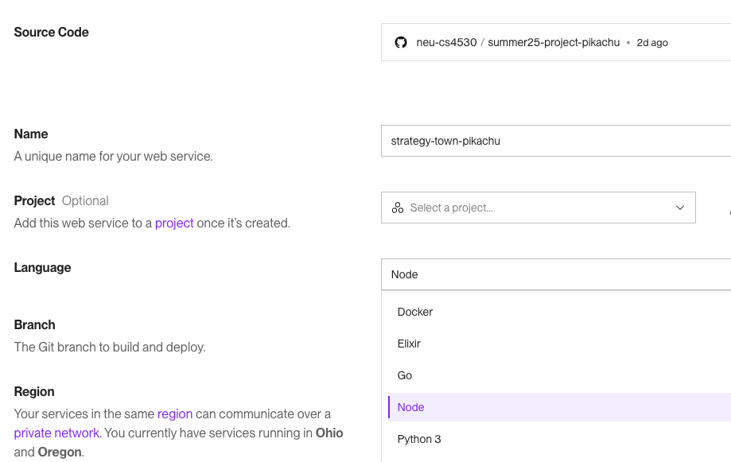
Continuous Deployment on Render
For apps doing basic things with JS (or Go, or Python…) Render can hide the fact you’re using containers behind some friendly web-form config

Slide 14

Continuous Deployment on Disco
https://disco.cloud
(Greg and Antoine are very friendly!)
The raspberry pi in my utility closet does all the steps that Render does, basically, with Disco!
./Dockerfile
# This file is one way of describing how to build
# and run strategy.town FROM node:24-slim
WORKDIR /code
# start with dependencies to enjoy caching
COPY ./package.json /code/package.json
COPY ./package-lock.json /code/package-lock.json
COPY ./shared/package.json /code/shared/package.json
COPY ./server/package.json /code/server/package.json
COPY ./client/package.json /code/client/package.json
RUN npm ci
# copy rest and build
COPY ./ /code/.
RUN npm run build -w=client CMD ["npm", "run", "start", "-w=server"]
./disco.json
{
"version": "1.0",
"services": {
"web": { "port": 8000 }
}
}
<- tells disco that this is a web service that expects connections on port 8000
<- Docker is the prevailing container platform; the Dockerfile describes how to build the container the app is built in and runs in

Slide 15
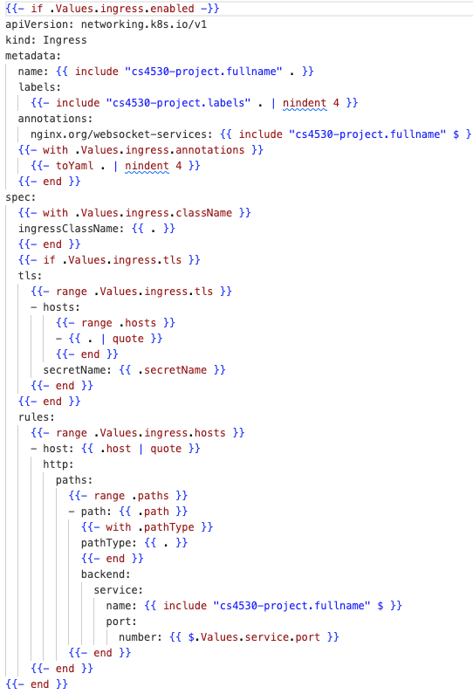
Continuous Deployment on NU’s Private Cloud
./helm/templates/ingress.yaml
./Dockerfile
# This file is one way of describing how to build
# and run strategy.town FROM node:24-slim
WORKDIR /code
# start with dependencies to enjoy caching
COPY ./package.json /code/package.json
COPY ./package-lock.json /code/package-lock.json
COPY ./shared/package.json /code/shared/package.json
COPY ./server/package.json /code/server/package.json
COPY ./client/package.json /code/client/package.json
RUN npm ci
# copy rest and build
COPY ./ /code/.
RUN npm run build -w=client CMD ["npm", "run", "start", "-w=server"]
<- no clue tbh, and there are like a dozen of these files

Slide 16
Continuous Deployment
Common elements:
Dependencies
“Do normal node stuff” (Render) vs Dockerfile (Render, Disco, NU)
Configuration
Web-based config (Render), config file (Disco), something else (NU)
Secrets and environment variables (i.e. MONGODB_CONNECTION_STRING)
Don’t check your secrets in to your repo!
Web-based config (Render, Disco)
GitHub secrets that get passed to the container-running machines (NU)

